Slide 1

Brain Initiative Informational Conference Call
RFA-NS-14-007
RFA-NS-14-008
RFA-NS-14-009
Feb 4, 2014

Slide 2
Overview of BRAIN FOAs
Previous Informational Conference Calls
RFA-MH-14-215 -- Transformative Approaches for Cell-Type Classification in the Brain
    Pilot strategies for a systematic inventory of cell types in the brain
RFA-MH-14-216 -- Development and Validation of Novel Tools to Analyze Cell-Specific and Circuit-Specific Processes in the Brain
    Tools for a high degree of cell-type or ciurcuit-level specificity
    Delivery of genes/molecules to specific cells of interest
    Targeting specific cell types/circuits with greater precision & sensitivity
RFA-MH-14-217 -- Planning for Next Generation Human Brain Imaging
    Teams of imaging scientists and experts from a range of disciplines
    Plan for new generation non-invasive imaging of human brain function
Full list of FOAs with contact information: http://www.nih.gov/science/brain/funding.htm

Slide 3
Overview of BRAIN FOAs
Today’s Conference Call – Dr. Kip Ludwig
RFA-NS-14-007 -- New Technologies and Novel Approaches for Large-Scale Recording and Modulation in the Nervous System
    Record and manipulate neural activity
    Cellular resolution, at multiple spatial and/or temporal scales, in any region and throughout the entire depth of the brain
    New approaches, novel techniques, proof-of-concept studies
RFA-NS-14-008 -- Optimization of Transformative Technologies for Large Scale Recording and Modulation in the Nervous System
    Record and manipulate neural activity
    Cellular resolution, at multiple spatial and/or temporal scales, in any region and throughout the entire depth of the brain
    Optimize existing or emerging technologies/approaches, iterative refinement for broad dissemination

Slide 4
Overview of BRAIN FOAs
Today’s Conference Call – Dr. James Gnadt
RFA-NS-14-009 -- Integrated Approaches to Understanding Circuit Function in the Nervous System
    Exploratory studies, new and emerging methods for large scale recording/manipulation
    Understand neural basis of a specific behavioral or neural system
    Teams of investigators, integrated development of experimental, analytic, theoretical capabilities
    Preparation for a future competition for large-scale multi-project awards

Slide 5
RFA-NS-14-007 vs RFA-NS-14-008
RFA-NS-14-007 -- New Technologies and Novel Approaches for Large-Scale Recording and Modulation in the Nervous System
  Record and manipulate neural activity
  Cellular resolution, at multiple spatial and/or temporal scales, in any region and throughout the entire depth of the brain
  New approaches, novel techniques, proof-of-concept studies
RFA-NS-14-008 -- Optimization of Transformative Technologies for Large Scale Recording and Modulation in the Nervous System
  Record and manipulate neural activity
  Cellular resolution, at multiple spatial and/or temporal scales, in any region and throughout the entire depth of the brain
  Optimize existing or emerging technologies/approaches, iterative refinement for broad dissemination
  Proof-of-concept already in-hand!

Slide 6
Is my project appropriate for RFA-NS-14-007/8?
General Goals for RFA-NS-14-007/8
Develop New Large-Scale Network Recording Capabilities
Develop Tools for Circuit Manipulation
Link Neural Activity to Behavior
    For details, refer to the “Objectives” section in
    RFA-NS-14-007 or RFA-NS-14-008

Slide 7
Is my project appropriate for RFA-NS-14-007/8?
Examples of Approaches for RFA-NS-14-007/8
Probes for Large Scale Sensing and/or Manipulation of Neural Activity in Vivo
Imaging Instrumentation for Recording and/or Manipulating Neural Activity with Cellular Resolution in Vivo
Development of Electrodes for Large-Scale Recording and/or Circuit Manipulation in Vivo
Techniques and Approaches for Recording/Manipulating Neural Activity during Behaviors
    For details, refer to the “Objectives” section in
    RFA-NS-14-007 or RFA-NS-14-008

Slide 8
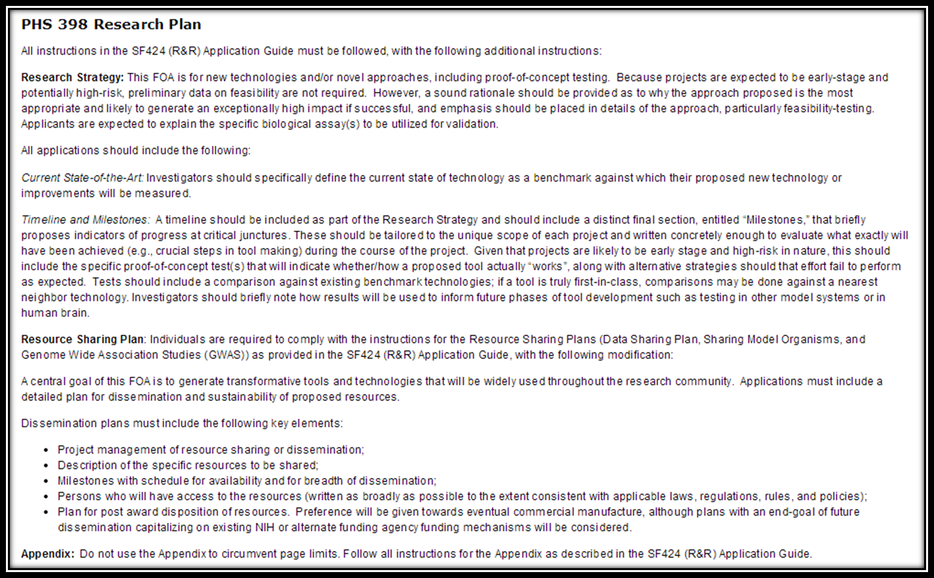
Mandatory Components of the Research Plan FOA 007
Section IV, “Research Strategy” from RFA-NS-14-007

Slide 9
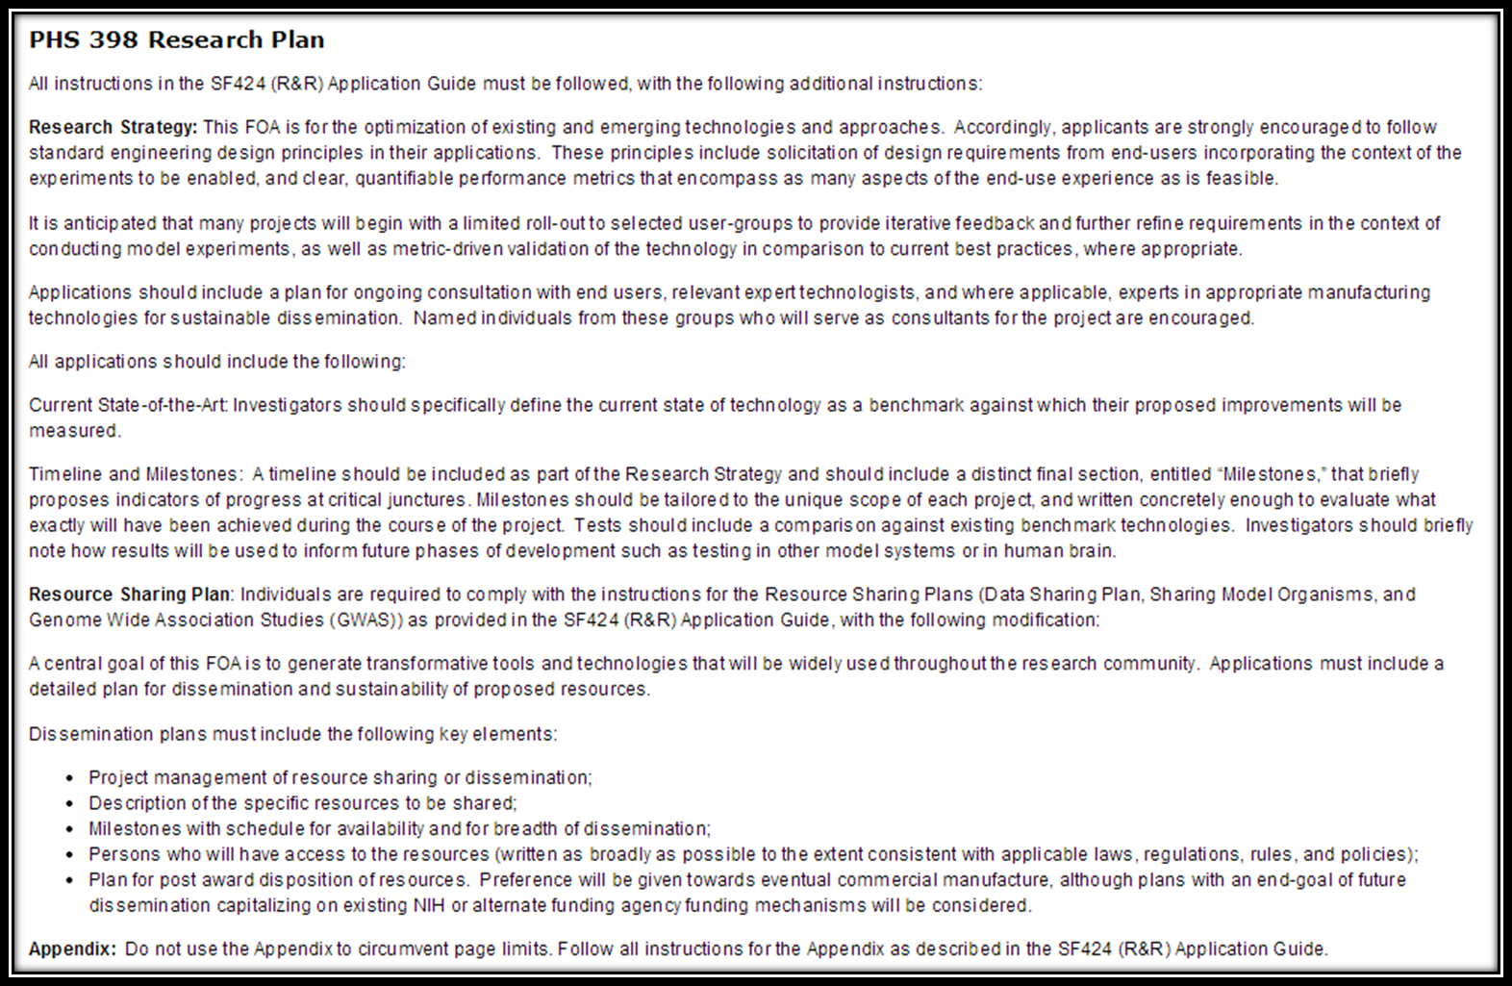
Mandatory Components of the Research Plan FOA 008
Section IV, “Research Strategy” from RFA-NS-14-008

Slide 10
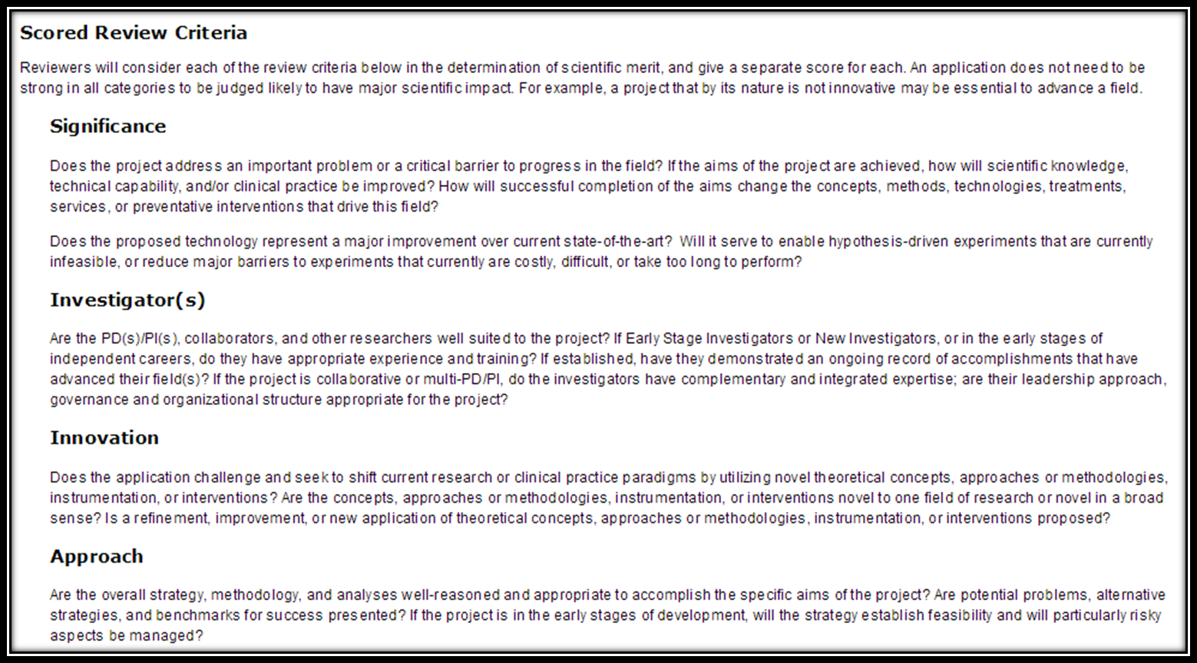
Review Criteria FOA 007
Section V, “Scored Review Criteria” from RFA-NS-14-007

Slide 11
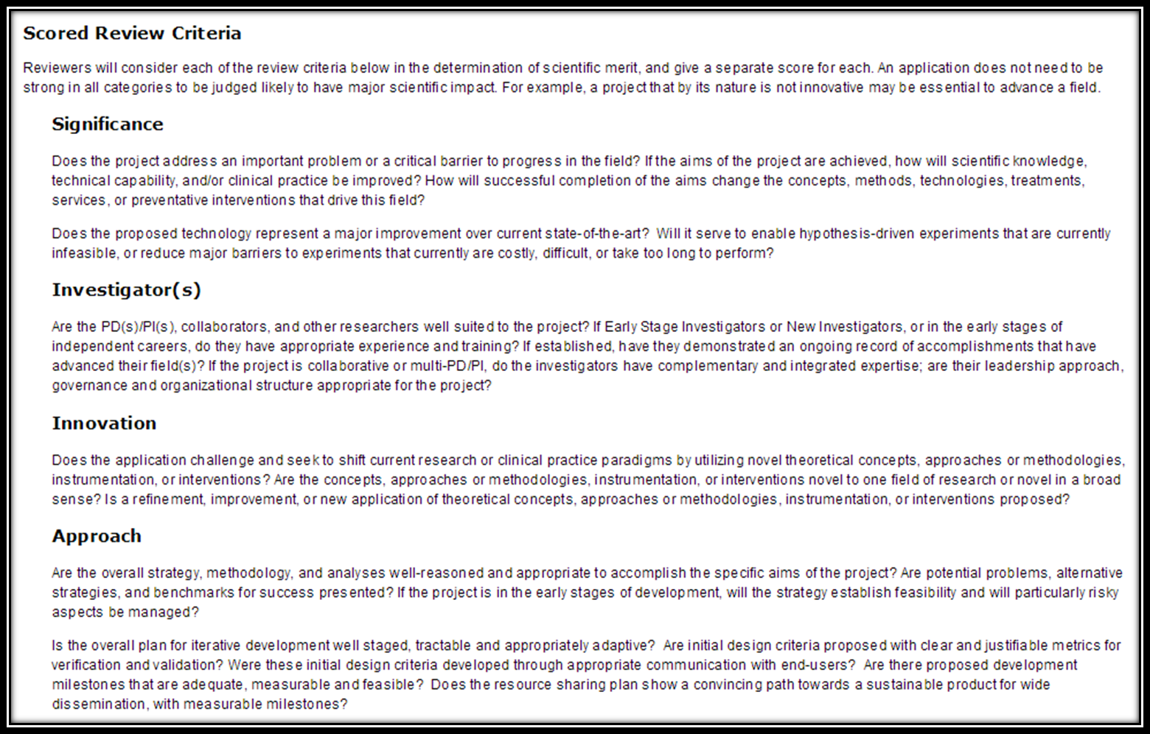
Review Criteria FOA 008
Section V, “Scored Review Criteria” from RFA-NS-14-008

Slide 12
RFA-NS-14-009
  Integrated Approaches to Understanding Circuit Function in the Nervous System
    Exploratory studies in preparation for a future competition for large multi-component awards.
    Large-scale analysis of a specific neural system or circuit in conjunction with ethologically relevant behavior.
    Integrate theory and modeling with new and emerging methods for recording and manipulating neural circuits across multiple brain regions
    Projects are anticipated to be early-stage and potentially high-risk.

Slide 13
RFA-NS-14-009
  Applications should address the following considerations (Section I from the FOA):
    Employ new and emerging capabilities for large scale recording and/or manipulation of circuits.
    Applied to a specific circuit or neural system.
    Provide rich information on cell-types and circuits.
    Employ sophisticated analysis of ethologically relevant behaviors.
    Integrate across innovative approaches for observation, experimentation and theoretical modeling.
    Develop new principles and methods for data acquisition, analysis and interpretation.
    Demonstrate transformative understanding.
    Plan for effective approaches to large-scale data analysis, storage and dissemination.

Slide 14
RFA-NS-14-009
  Research strategy should include the following points (Section IV, 2. from the FOA):
    Statement of the neurobiological questions to be addressed.
    Justification of the team of experts to address multiple components of approach.
    Detailed description of the theories and models that frame explicit empirical questions, and discussion of the analytical tools for interpretation of results.
    Description of large-scale recording/manipulation methods that will be employed or developed to approach the questions as a functional system.
    Explanation of the experimental strategies to investigate mechanisms within the circuits studied.
    Description of tractable goals or milestones for the project, which will serve as a basis for a subsequent application in a competition for large-scale, multicomponent projects.

Slide 15
RFA-NS-14-009
  Representative, but not exhaustive, examples of responsive topics (Section I from the FOA):
    Network coding of sensory information
    Motor circuit dynamics during volitional behaviors
    Neural activity associated with social or cognitive behaviors
    Changes in functional circuit connectivity in learning and memory
    Circuit basis of motivational states, rewarded behavior and decision making
    Understanding the flow and computation of information within neural circuits during active behaviors
    Assessing distributed representations of perceptual, cognitive, or decisional constructs

Slide 16
Overview of BRAIN FOAs
Comparing RFA-NS-14-007 vs. 008 vs. 009
Novel Technology
(RFA-007)
Optimization of Technology
(RFA-008)
Integrated Approaches
(RFA-009)
Establish proof of concept for technology
End-Point demonstrates feasibility / utility
Proof of concept already in-hand
Refinement with broad community of end-users
Path towards wide dissemination
Technology implementation for a biological question; end-user is the research team
Integration of theory and experimentation to address a common research goal
Preparation for future competition for large-scale awards

