Slide 1




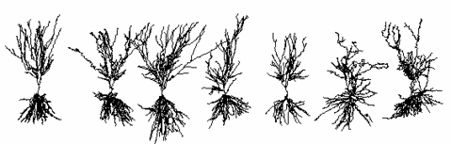
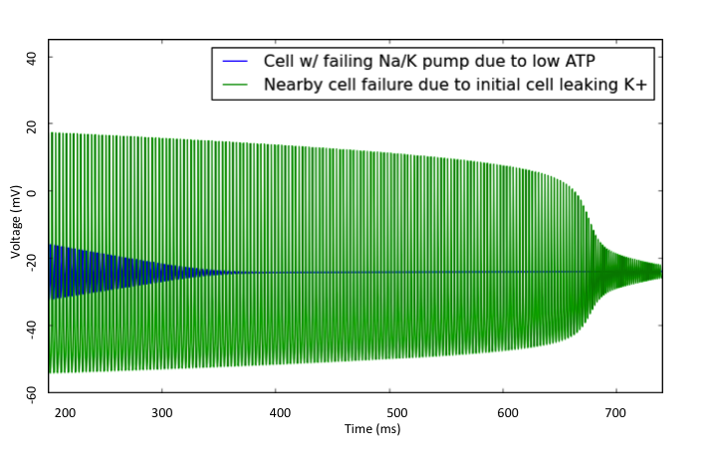
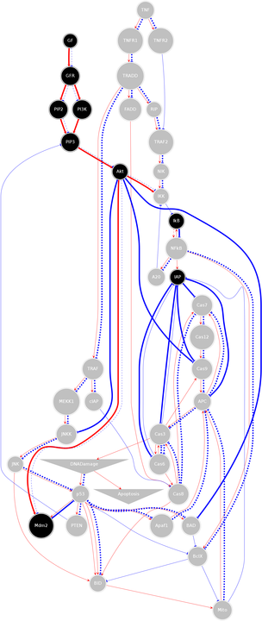
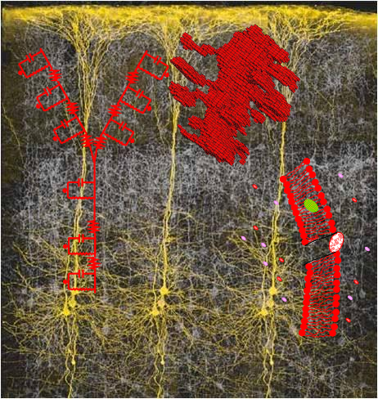
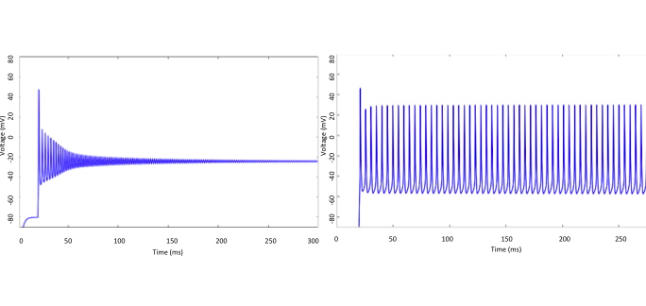
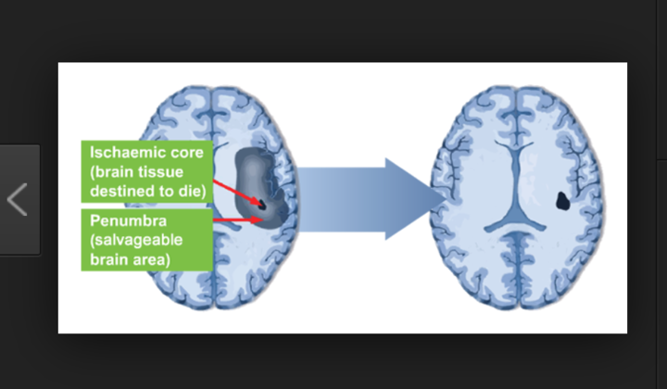
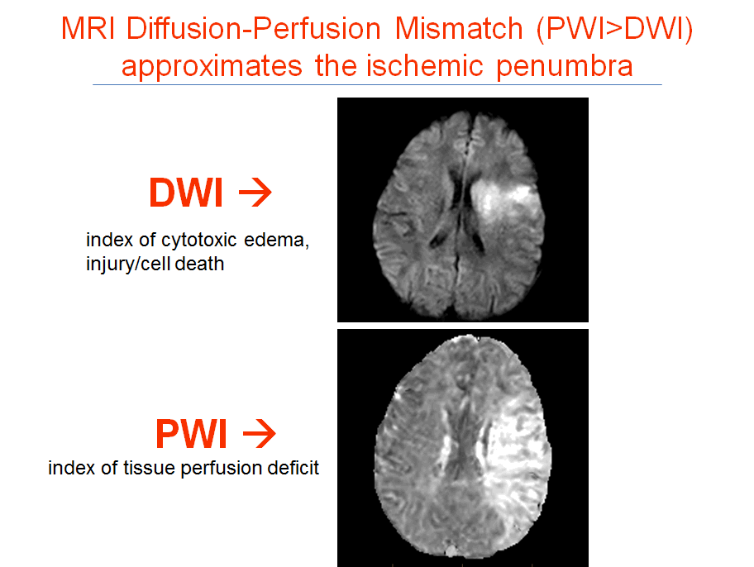
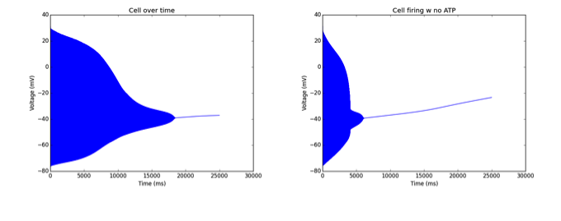
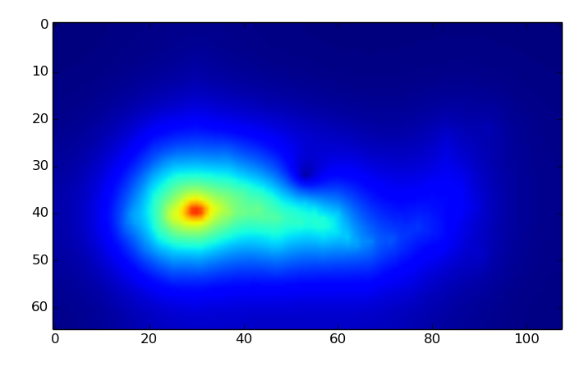
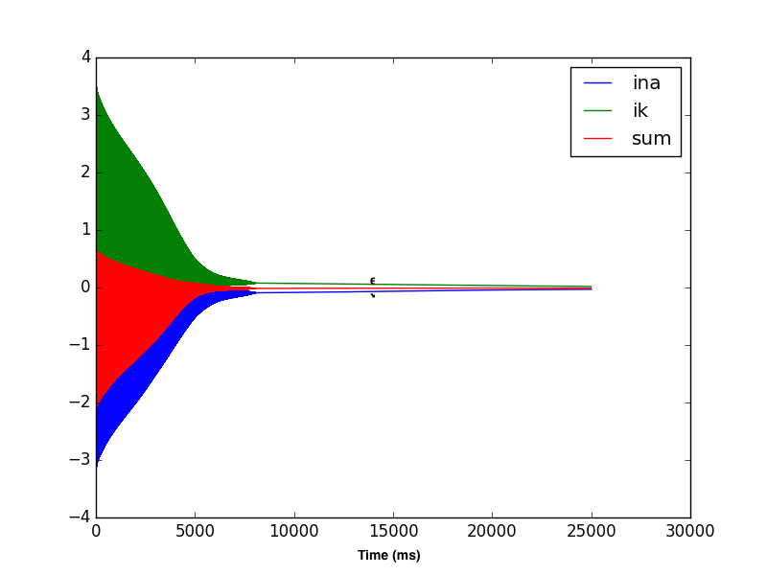
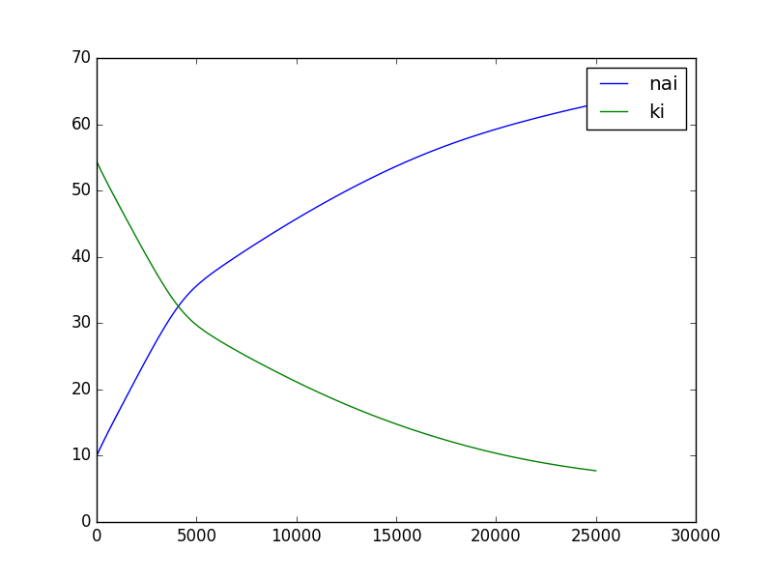
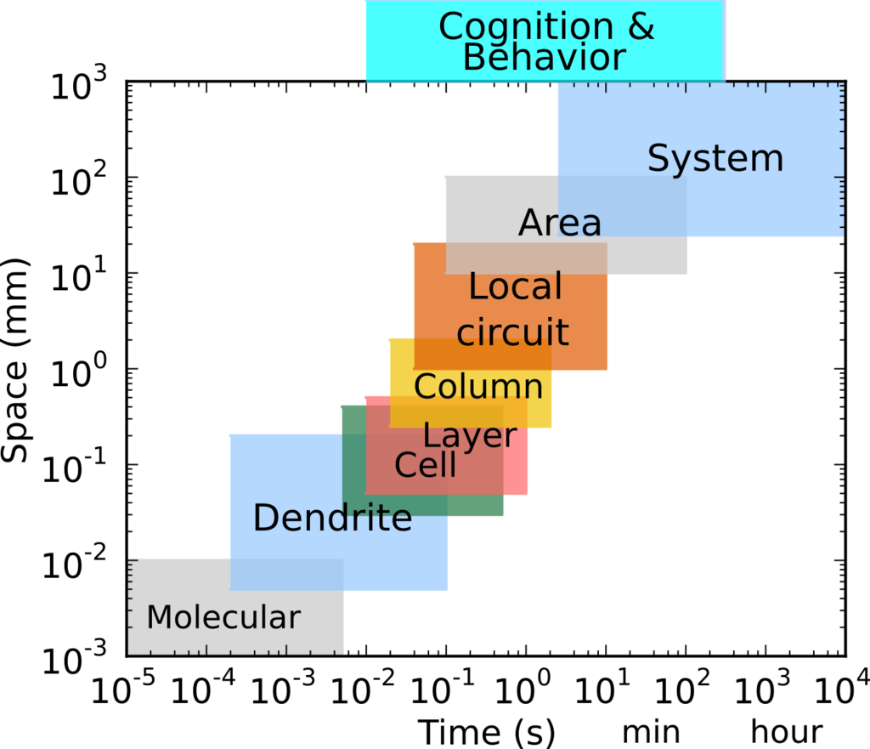
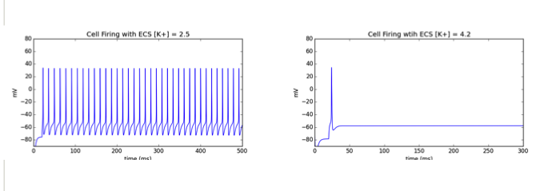
Mosaic multiscale computer modeling of ischemic stroke
Alexandra H. Seidenstein^{1,2}; Robert, A. McDougal³ ; Sam A. Neymotin¹; Frank C. Barone¹; Michael L. Hines^{3;} William W. Lytton^{1,4}
¹SUNY Downstate Medical College, ²New York University ,³Yale University, ⁴Kings County Hospital
Abstract
Mosaic Model
Na+/K+ Pump Failure and Recovery
Ischemia must be modeled across mutliple temporal and spatial scales.
Tissue scale: Ischemic core (cells die) and Penumbra (cells may be salvageable)
Large multiscale models require new simulations technologies : augment NEURON simulation capabilities
Addition of Extracellular Space (ECS) & Na+/K+ Pump (ATPase) greatly increases relevancy ischemic modeling
a.
a). ‘Umbra’ cell failure to fire due to ATP = 0, and therefore inability of Na+/K+ pump and leakage of K+ into ECS. Cell that is 1mm away has eventually inability to fire due to high K+ concentration, despite standard ATP levels and Pump activity.
a
d
b
c
Umbra and Penumbra
b
C
a
b
(b) Cell fails to fire due to high ECS K+ concentration = 5, Na+/K+ pump rate = 100. (c) Cell recovery due to the high ECS K+ concentration, by increasing the Na+/K+ pump, rate = 150.
These multiscale models (MSMs) are extremely complex: time scales ms-hours; spatial scales micron-centimeters, so tremendous challenge to run a “full model”. Novel method of mosaic modeling allows for detailed arts on background of rough sketch. Ability to model important cellular components of ischemic stroke (a) Cells can be implemented at various levels of detail and may be networked. (b) The mosaic. (c )Boolean model of caspace cascade of apoptosis. (d). Chemical signaling and molecular cascades are included in some cells.
Model Cell: NeoCortical Pyramidal w/ Na+/K+ Pump
The umbra is the immediate region of the ischemic event. The penumbra is the often salvageable region surrounding the umbra. After ischemia brain tissue will have likelihood of increase because of cellular spreading mechanisms. (a) potential neuroprotection has the ability to reduce the size of damage resulting from the stroke. (b) PWI v DWI shows the difference in region between umbra and penumbra. PWI being able to detect possible region and size of penumbra.
a
b
Extracellular Space
a
(a) Visual representation of the diffusion of ions throughout the Extracellular Space away from the initial cell. Ion concentration change due to rupture or excitotoxicity will effect ECS and then surrounding cells.
Multi Scale Modeling
c
d
b
c
(a)Pyramidal cell w/ added pump and specific Ion Leaks firing w added stimulation over 25K ms. (b-d) Cell with ATP levels = 0, and inability for Na+/K+ pump to maintain activity. (b) Cell firing over 25K ms. (c) Na, K and sumcurrent over time. (d) Change in internal K+ and N+ concentration over time.
Future Directions
Excitotoxicity – EC glutamate, IC Ca2+, CICR
Extracellular Space – effects of edema
Pump Failures and regulation – ATP/OGD
Vasculature – blood vessels as sinks
Spreading depression
Spreading toxicity – ROS
(b) Cell firing w/ homeostatic ECS K+ levels = 2.5 (c) Cell failure to fire due to increase in the extracellular K+ levels = 4.2.
Acknowledgments
References
Gordon Sheperd
Salvador Dura –Burnal
Mohamed Sherif
Tommy Lee
Tom Morse
Supported by NIH Grant U01EB017695 R01MH086638
Ascoli GA, Donohue DE, Halavi M. (2007) NeuroMorpho.Org: a central resource for neuronal morphologies.J Neurosci., 27(35):9247-51
Donnan GA & Davis SM. Neuroimaging, the ischaemic penumbra, and selection of patients for acute stroke therapy. Lancet Neurol 2002;1:417-425.
Hubel, N, Andrew, RD., G. Ullah. Large extracellular space leads to neuronal susceptibility to ischemic injury in a Na+/K+ pumps–dependent manner J. Computational Neuroscience 2016 40:177-192
Liu S, Levine SR, Winn HR. Targeting ischemic penumbra: part I - from pathophysiology to therapeutic strategy. J Exp Stroke Transl Med. 2010;3(1):47-55.
Neymotin SA, McDougal RA, Bulanova AS, Zeki M, Lakatos P, Terman D, Hines ML, Lytton WW. Calcium regulation of HCN channels supports persistent activity in a multiscale model of neocortex. Neuroscience 2016 3136:344-366
Neymotin SA, McDougal RA, Sherif MA, Fall CP, Hines ML, Lytton WW. Neuronal calcium wave propagation varies with changes in endoplasmic reticulum parameters: a computer model. Neural Computation 2015 27(4):898-924.
Saver JL. Time is brain – quantified. Stroke 2006;37:263-266

Slide 2
